Slide 1

Rank Centrality

Slide 2

Introduction
Part 1 Introduction

Slide 3
Introduction
Rank Centrality
Intrinsic: a Markov chain constructed on the basis of the historical performance of different teams.
Key: construction of the transition matrix
Where P is transition matrix
The stationary distribution is the top left eigenvector of P，also is the final mark for teams

Slide 4
Part 2 Algorithm and result

Slide 5
Algorithm
Rank Centrality
A_{ij} is the probability of team j defeating team i,
is the maximum degree of node
(1) Where P is transition matrix
is the distribution of the random walk at time t,
this is the probability distribution of which
node we will be located at time t.
After initialising and constructing P,
we can then iterate equation (1) until stationary
distribution

Slide 6
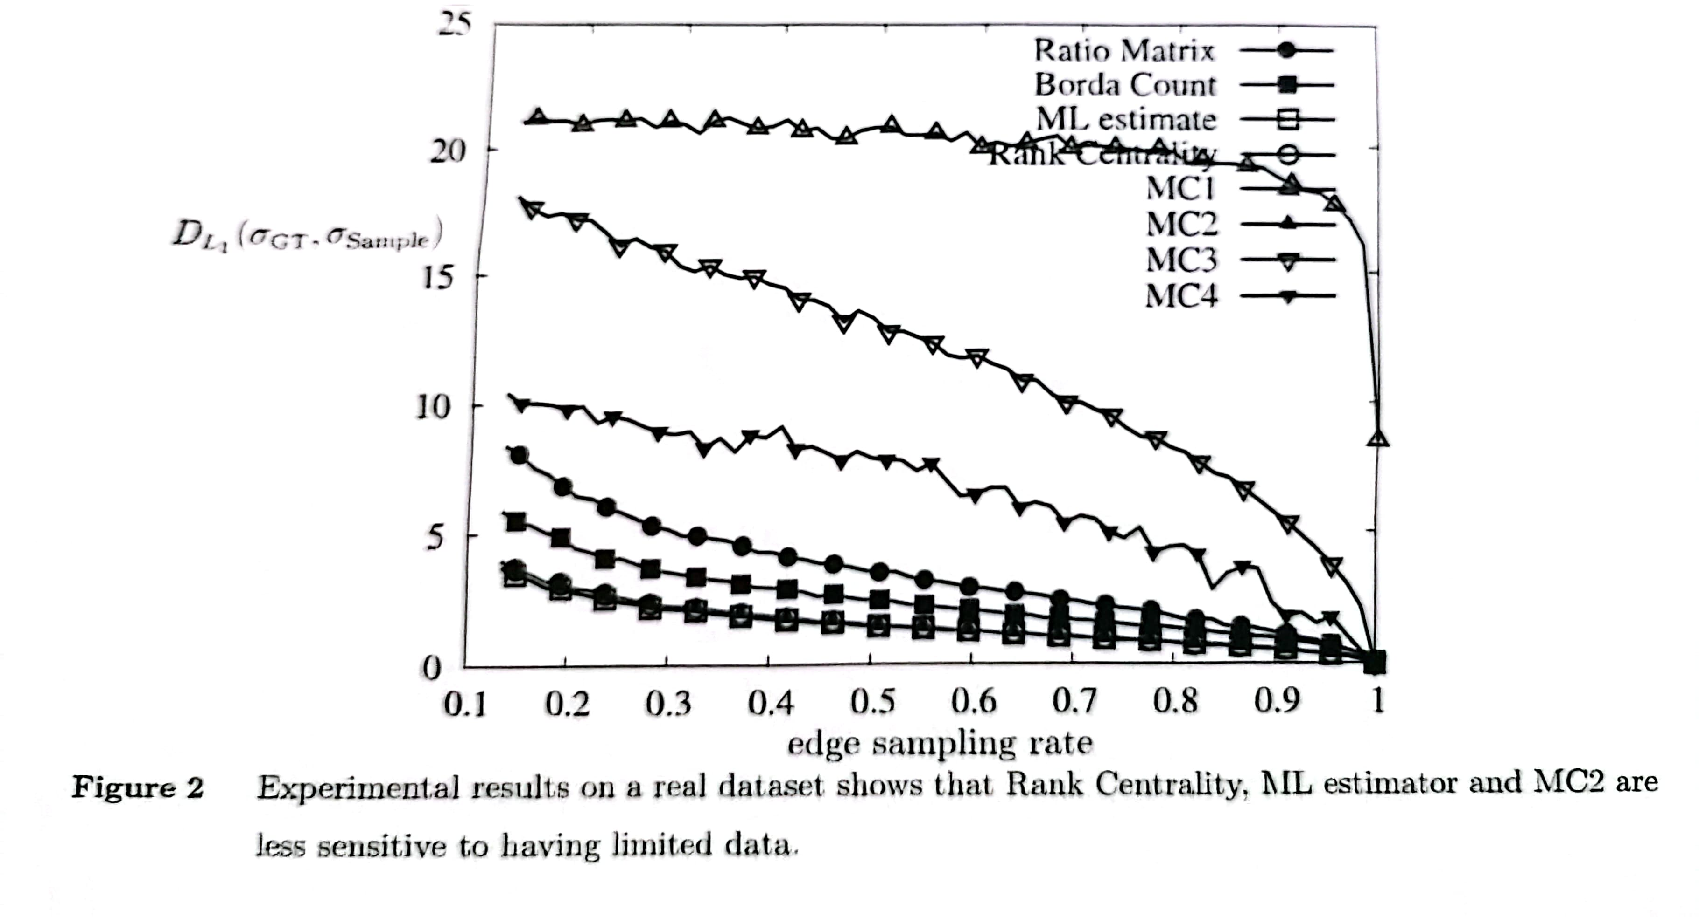
Result
Since the random walk will move from state i to state j with probability proportional to the chance that item j is preferred to item j. So whoever is stronger will score higher in the final stationary distribution
The rank centrality is compared with other spectral ranking
algorithms and the ML on the realdataset. It can be seen
that rank centrality and ML achieve the best results.

Slide 7
Part 3 problem in proof

Slide 8
Rank Centrality: Error bound for general graphs
Rank Centrality:Error bound for random graphs

Slide 9
1. Page 26 , below equation 14
How to get ?
p_{l} is any probability distribution, is the stationary distribution of
2. Page 27, How to derive equation 18 and 20 according to Azuma-Hoeffding's inequality?
3. Page 28, How to use Union bound derive equation in page 28?
4. In Lemma5, we assume , why?

Slide 10
Part 4 idea about this paper

Slide 12
Data Introduction and Data Analysis
Data analysis
Budget
Movie score, vote count and popularity
Genres
Released time of the movie

Slide 13
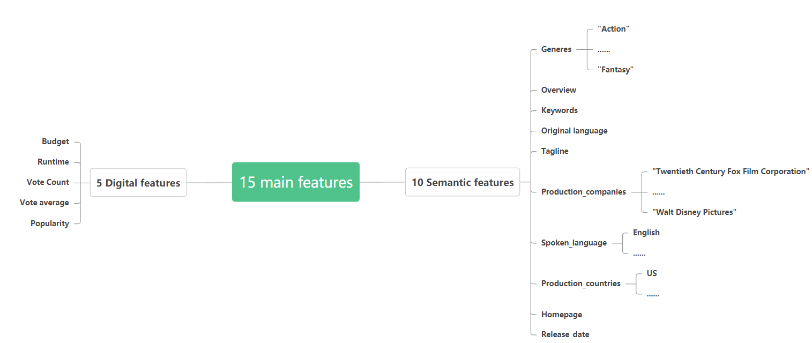
Data Introduction and Data Analysis
Data introduction
orignial 5000 samples data cleaning 4000 valid samples.

Slide 14
Data Introduction and Data Analysis
Budget
There is an obvious positive correlation between box-office and budget,whereas there are some films with high investment but low revenue.

Slide 15
Data Introduction and Data Analysis
Movie score, vote count and popularity
Total movie score is better to describe the movie score than average movie score, as its correlation coefficient with revenue is higher than average movie score.
variables | correlation coefficient
popularity and box office revenues | 0.60
popularity and vote count | 0.75
vote count and box office revenues | 0.76
average movie score and box office revenues | 0.19
Total movie score
=
Average movie score
×
Vote count

Slide 16
Data Introduction and Data Analysis
Genres
we set two samples to analyse the genres
Revenue over 400 million
Revenue-Budget ≤ $1000
Commercial success movie
Low-profit movie
compare the percentage of successful or low-profit films that contain the same genres of movies.

Slide 17
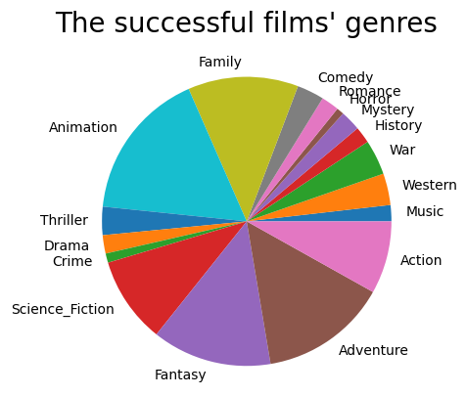
Data Introduction and Data Analysis
Genres
Animation
Adventure
Fantasy
Family
Action
Higher Proportion

Slide 18

Data Introduction and Data Analysis
Genres
Genres about low-profit films
Higher percentages in
History
Western
Drama
War
Crime.

Slide 19
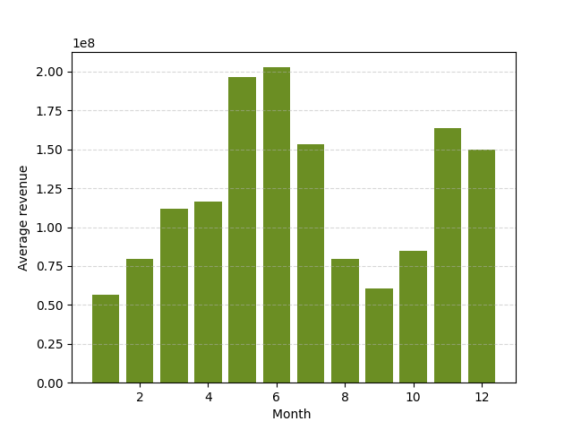
Data Introduction and Data Analysis
Released time
The released time is weekly related to box office revenues as it is influenced by many factors, such as holiday.
The average box-office is relatively high in summer vacation and winner vacation.

Slide 20
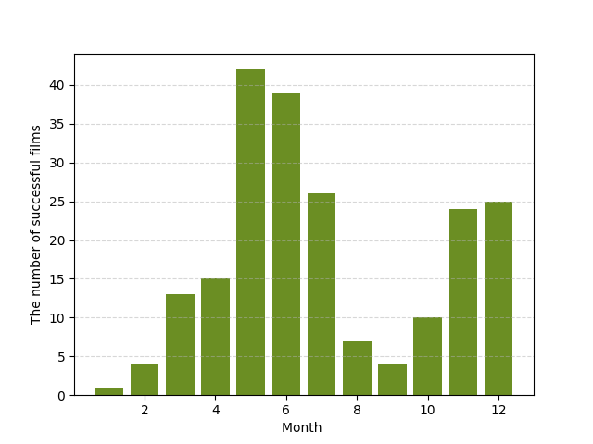
Data Introduction and Data Analysis
Released time
For individual films, there are more films that have over 400 million box-office revenues over the summer vacation.

Slide 21
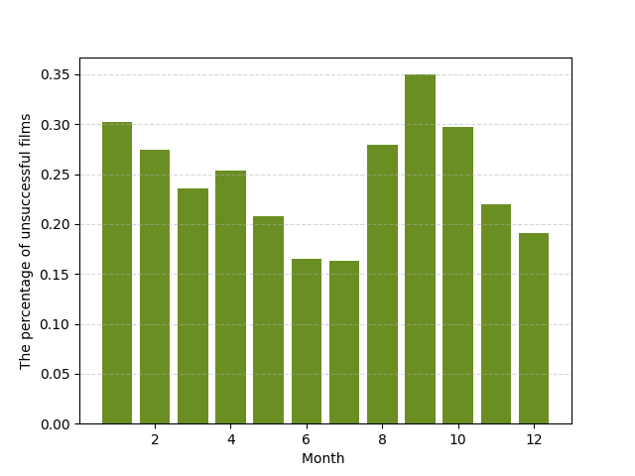
Data Introduction and Data Analysis
Released time
Compared with released movies, more films lost money in September.

Slide 22
Model Predictions
Part 3 Model Predictions
Deep Learning ----- Train dataset : Test dataset=7:3
Machine Learning -----K-fold cross-validation

Slide 23
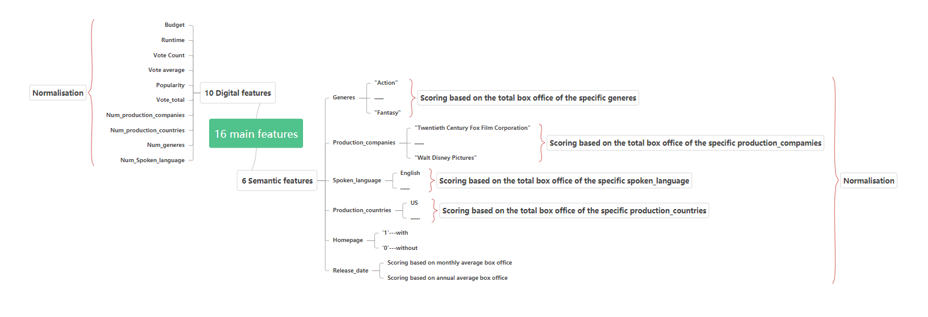
Model Predictions
Feature Engineering
Plot Heat Map (Explore the correlation between revenue and individual features)

Slide 24
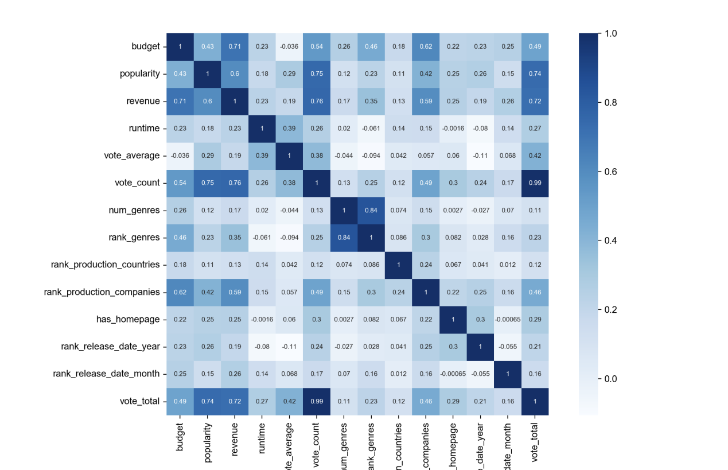
Model Predictions
Heat Map
Keep the 13 features with a correlation greater than 0.1 with the box office as our input.
Input

Slide 25
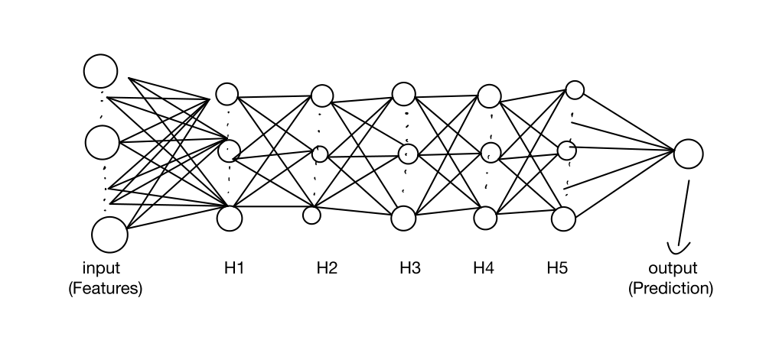
Model Predictions
ANN:
Five hidden layers （Determined from validation dataset, and also taking into account model run time)
Optimization methods (Small batch gradient descent) :
Aim: Reconcile stability and speed of convergence

Slide 26
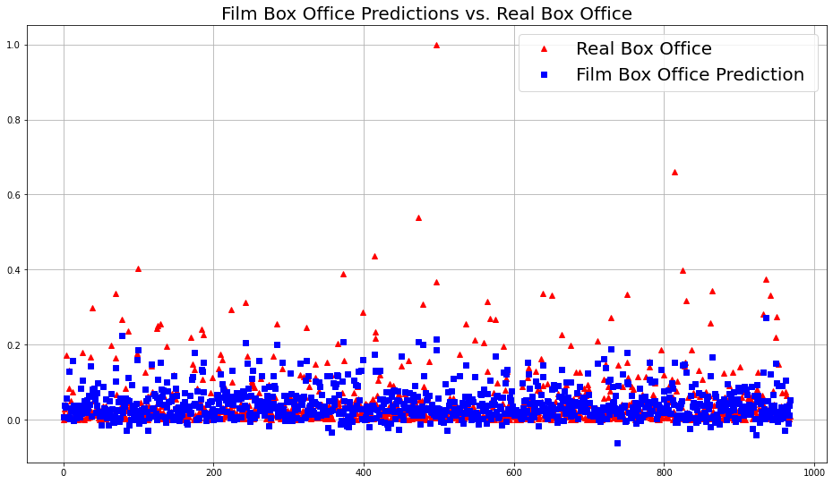
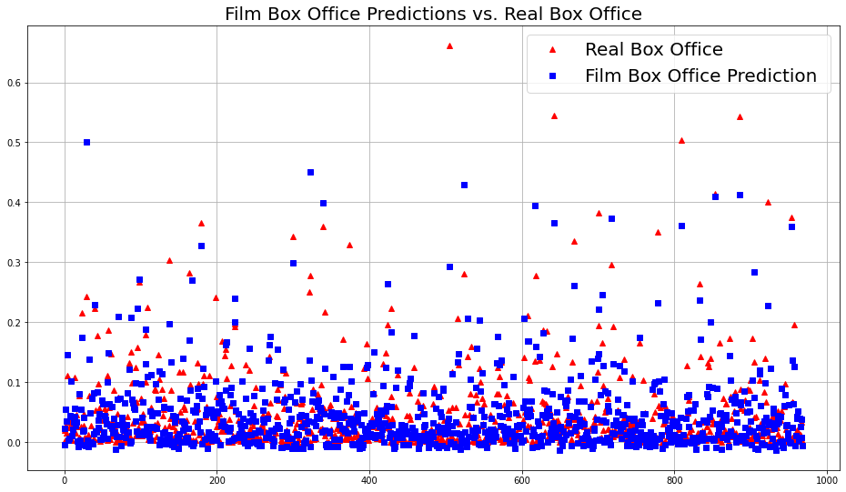
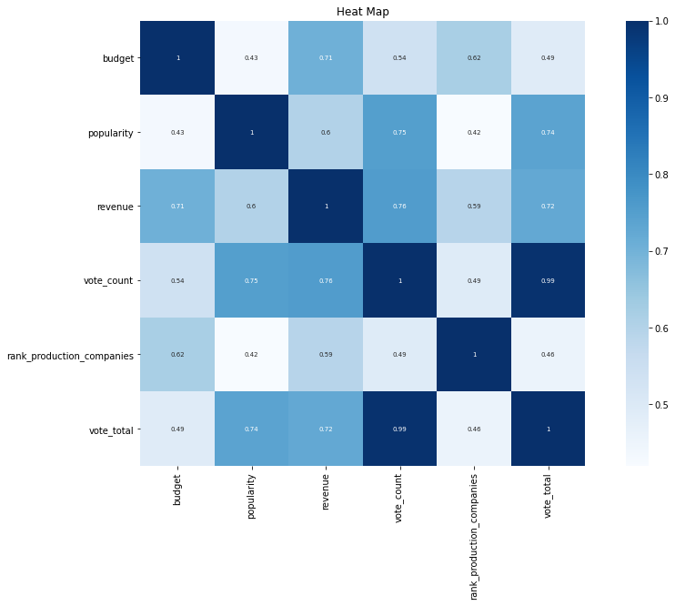
Model Predictions
Deep learning (ANN)
Result
Reduce Features
5 most important features
Number of features | 13
Accuracy (R2_Score) | 43%-52.8%
RMSE | 0.043-0.066
Number of features | 5
Accuracy (R2_Score) | 65%-79%
RMSE | 0.034-0.037
But accuracy in train dataset is 65%-80%
Good Job !!!!!
Overfitting !!!!!

Slide 27
Model Predictions
Machine learning
Machine Learning
1) Linear regression
2) Ridge regression
3) Random forests
4) Gradient Boosting Decision Tree (GBDT)
5) CatBoost
Model Stacking

Slide 28
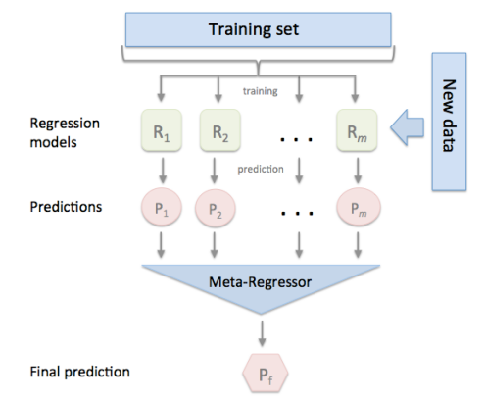
Model Predictions
Machine learning
Model Stacking
Using 5 models as sub-models and then using the predictions of these sub-models as features of the meta model.

Slide 29
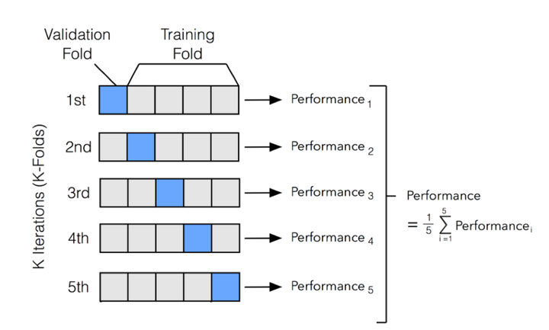
Model Predictions
Machine Learning
K-fold cross-validation （Reliable result and overcome small size dataset)
1. Firstly, dividing the full sample into 5 equally sized subsets of samples.
2. Iterate through these 5 subsets in turn, each time using the current subset as the validation set and all the remaining samples as the training set.
3. Finally, the average of R2_score of the 5 performance is taken as the final evaluation result.

Slide 30
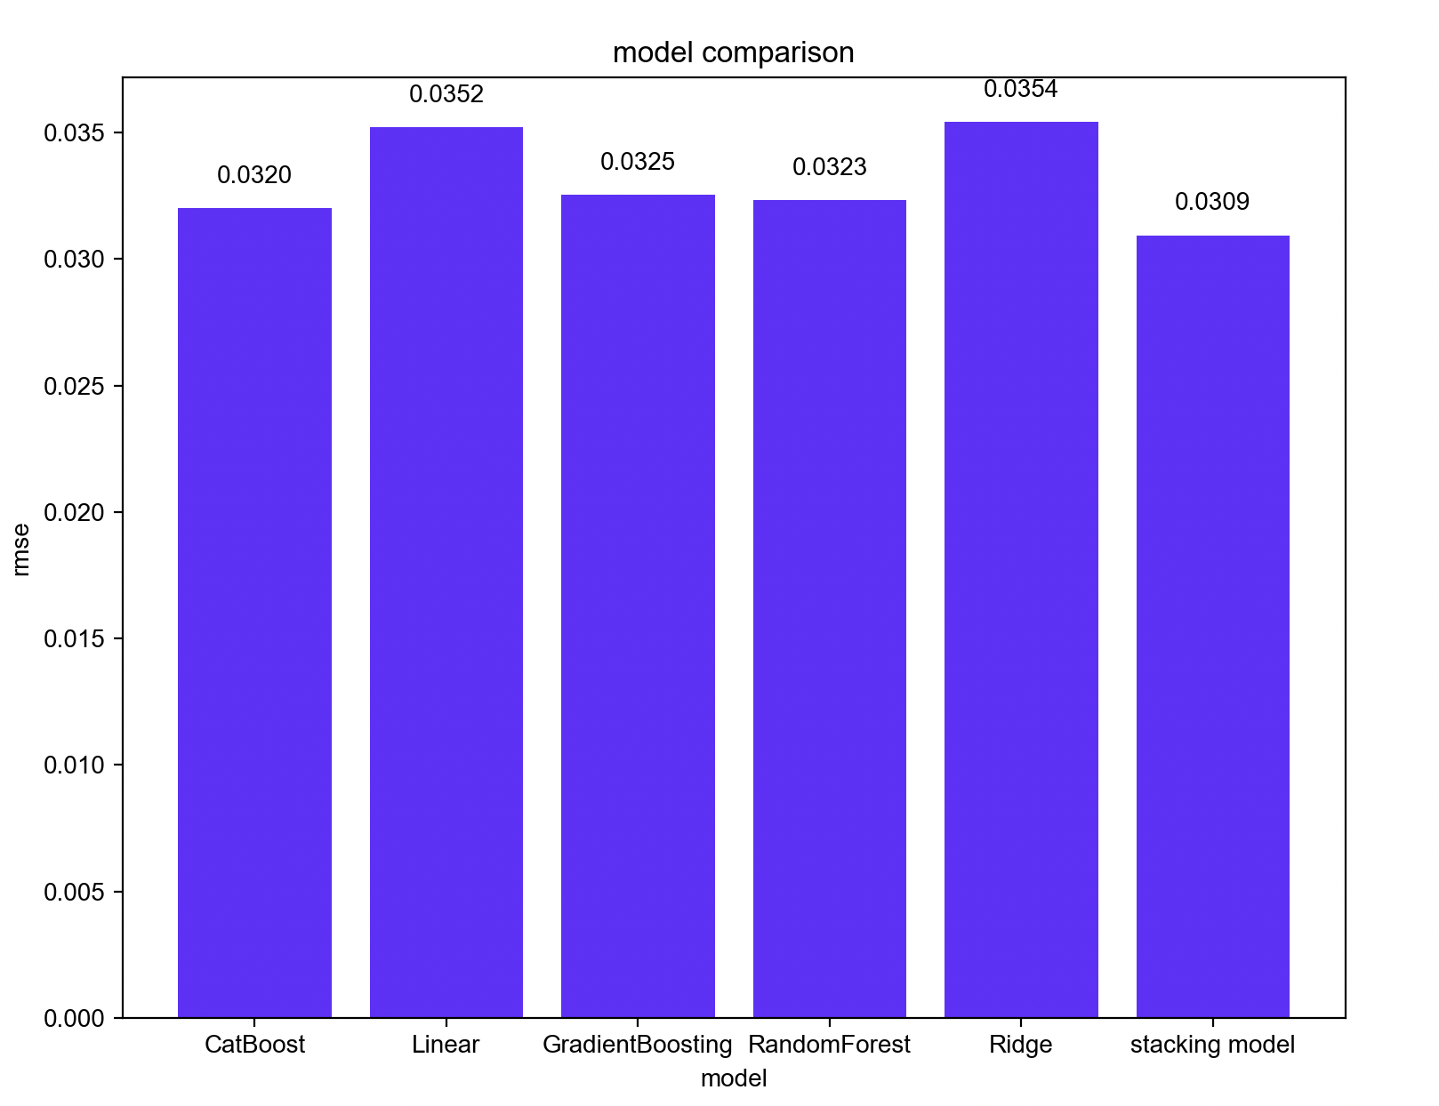
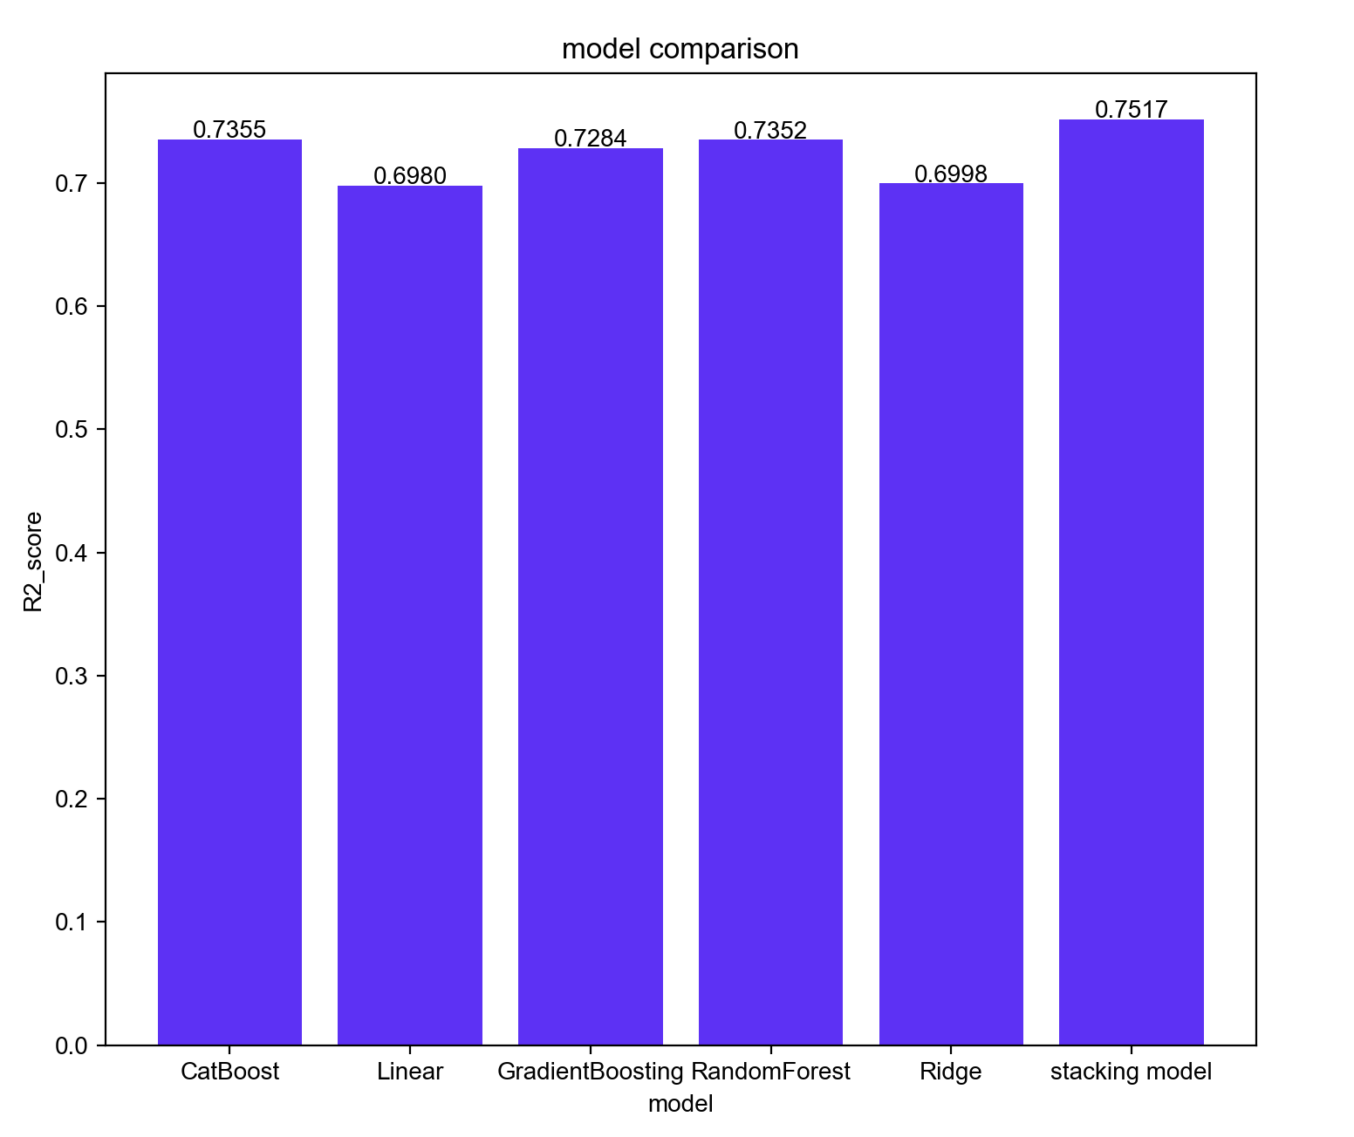
Model Predictions
Machine Learning
Machine learning
Great Job !!!!!!!!!

Slide 31
Conclusion
1. Greatest impact on a film's box office (revenue)
Genres
Budget
Popularity (Vote)
Revenue
2. Machine Learning > Deep learning in this dataset
Machine Learning:
1)Higher accuracy
2)More consistent 3)Lower time cost
(DL: 1 hour, ML: 1 min)

Slide 32
THANK YOU!

